Slide 1

DATABASE SYSTEMS (EIE36E): ORACLE DATA FORMATS (*2015)
Doc. Ing. Václav Vostrovský Ph.D.
Ing. Petr Hanzlík

Slide 2

Outline > Data formats
Meaning of data format
VSIZE
Numeric data types
String data types
Objects

Slide 3
Data Format Definition
Depends on the DBMS used
Actual way of storing and data format name may differ
When in need to optimize database in terms of data type used, refer to the documentation provided by DBMS vendor!

Slide 4
ORACLE DB : Internal representation size
VSIZE is a function that returns the number of bytes used for internal representation of a property
VSIZE syntax:
VSIZE (property)

Slide 5
ORACLE DB : Storing numbers
NUMBER (precision, scale)
requires from 1 to 22 bytes of storage space
precision represents total number of digits
scale represents number of digits to the right of the decimal point
if a precision is not specified, the column stores values as given. If no scale is specified, the scale is zero.

Slide 6
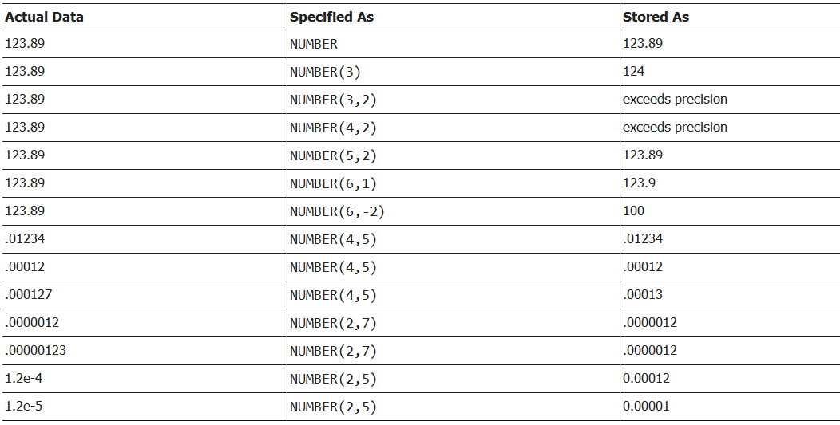
ORACLE DB : Storing numbers
NUMBER (precision, scale)

Slide 7
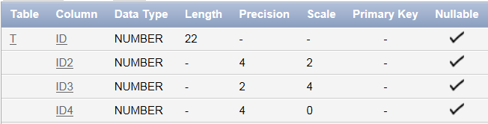
ORACLE DB : Storing numbers
create table t (id number, id2 number (4,2), id3 number (2,4), id4 number(4))
When no precision is specified, the maximum admissible size of NUMBER data type is presented

Slide 8
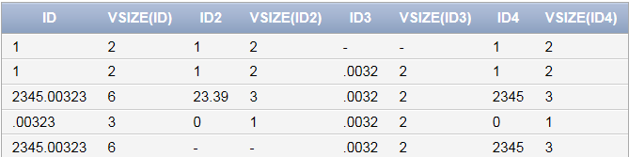
ORACLE DB : Storing numbers
create table t (id number, id2 number (4,2), id3 number (2,4), id4 number(4))
insert into t values (1,1,1,1)
insert into t values (1,1,'',1)
insert into t values (1,1,'0.0032',1)
insert into t values (1,1,'0.0330',1)
insert into t values (2345.00323,23.391,0.00323,2345.00323)
insert into t values (0.00323,0.00323,0.00323,0.00323)
insert into t values (2345.00323,'223',0.00323,2345.00323)
insert into t values (2345.00323,'',0.00323,2345.00323)

Slide 9
ORACLE DB : Storing numbers
NUMBER (precision, scale)
Variable space is dedicated for data declared as NUMBER
Precision determines how many positions for number are at your disposal
Scale operates decimal point
Length = byte size

Slide 10
ORACLE DB : Storing numbers
FLOAT (precision)
Subtype of Number
Scale is automatically depicted from data
BINARY_FLOAT, BINARY_DOUBLE
Fixed size number types
Float stores data in 4 bytes, double in 8
Both types use one byte of length data too

Slide 11
ORACLE DB : Storing characters
CHAR (size)
Stores fixed-length character strings
Always occupies the full space specified in size
Maximum size is 2000 bytes or characters
Default and minimum size is 1 byte

Slide 12
ORACLE DB : Storing characters
VARCHAR (length)
stores variable-length character strings
occupies only the space actually needed
VARCHAR is currently synonymous to VARCHAR2
Maximum size is 4000 bytes or characters, and minimum is 1 byte or 1 character.
You must specify size for VARCHAR!

Slide 13
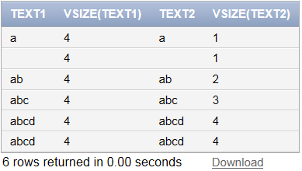
ORACLE DB : CHAR vs. VARCHAR
CREATE TABLE t (id NUMBER PRIMARY KEY, text1 CHAR(4), text2 VARCHAR(4))
SELECT text1,VSIZE(text1),text2,VSIZE(text2) from t

Slide 14
ORACLE DB : Complex data types
BLOB, CLOB
OB stands for Large OBject, a stream of data stored in a database
CLOB is encoding and collation sensitive
Typically used for images, audio and other multimedia objects, or binary executable code

Slide 15
ORACLE DB : More about data types
http://docs.oracle.com/cd/B28359_01/server.111/b28286/sql_elements001.htm#i45694

